Slide 1

INVENTORY MANAGEMENT SYSTEM
Submitted by shibin varghese(20048359)
professor:Kanza Ali Manzar

Slide 2
INTRODUCTION
The project focuses on the development of an Inventory Management System for a small Retail Tech company.
The roles and responsibilities of the various users are put into consideration so as to enhance data integrity, security, and operational efficiency.

Slide 3
STACKS USED
Frontend:
JavaScript- has been used in making the user interface interactive
HTML –has been used in the creation of the content on the web pages
CSS- has been used in enhancing the visual appeal of the website.
Backend:
JavaScript: has been used in facilitating the communication between the frontend and the backend.
SQL: has been used in the storage and the manipulation of data.
Database:
SQL database for secure and organized data storage.

Slide 4
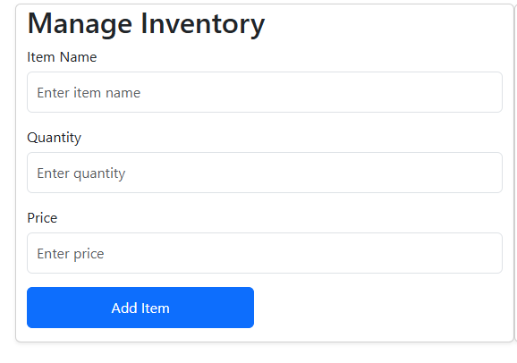
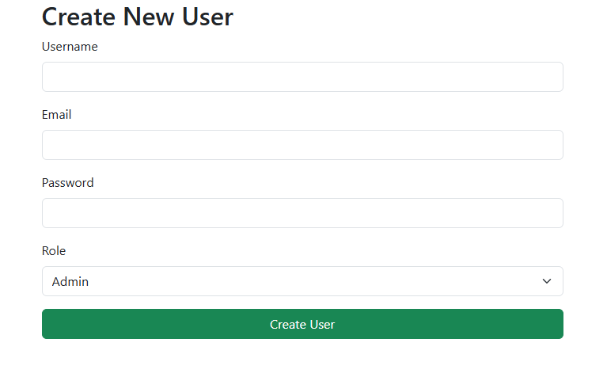
THE CRUD IMPLEMENTATION
Create:
Inventory items can be added and new users registered into the database as well.

Slide 5
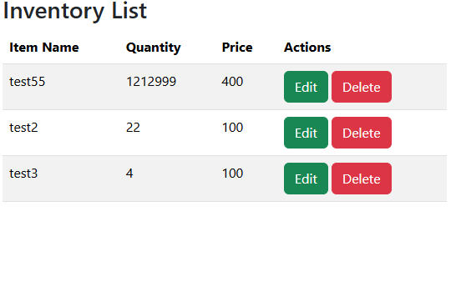
Read:
The saved inventory can be viewed from the database.

Slide 6
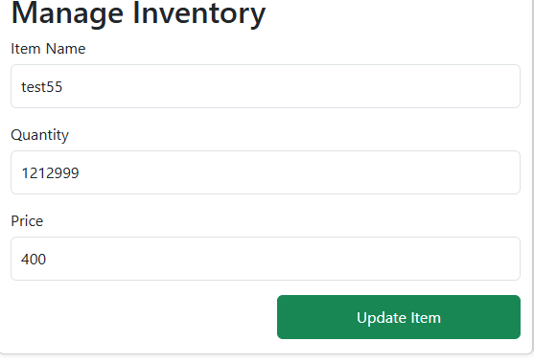
Update:
Inventory items can have their details modified.

Slide 7
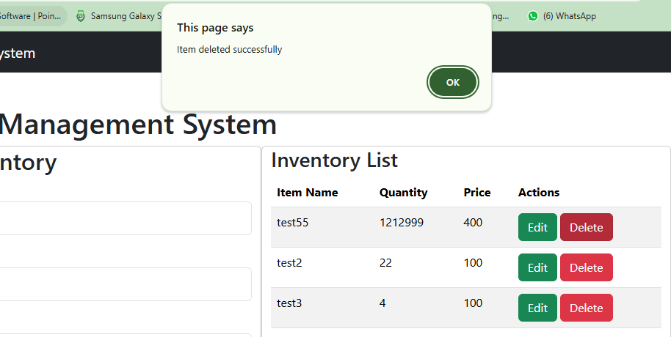
Delete:
Discontinued items can be removed from the inventory.

Slide 8
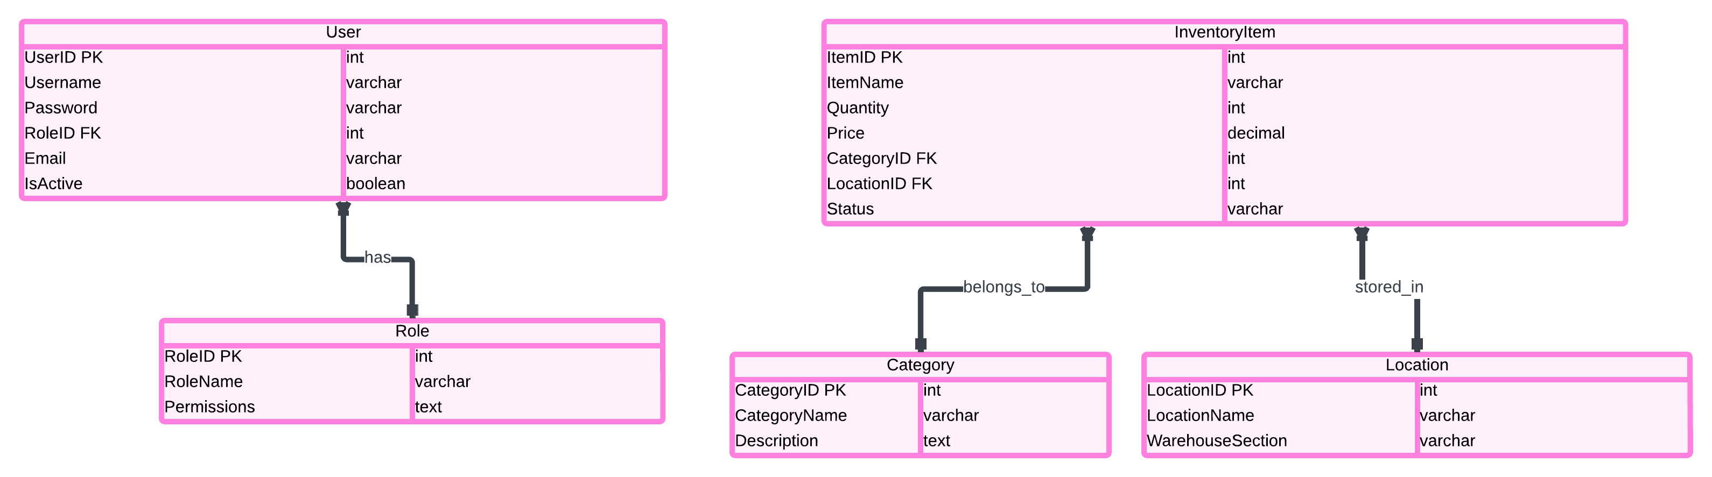
ER-diagram

Slide 9
Entities: User: end users and power users; Role: system roles; Inventory: items on inventory; Category: buying category; Place: geographic location Relationships: Users and Roles: Inventory Items consist of products and services that a business enterprise holds for the sale of its products and services while inventory categories are the grouping of inventory items based on certain characteristics

Slide 10
Testing And Validation
Unit Tests: Writing unit tests for CRUD operations for a specific function
Integration Tests: To guarantee the smooth and proper connectivity of components
Security Tests: The FileMaker Pro application also validates the access restrictions wherever necessary
Load Testing: Evaluating the performance of an algorithm in the presence of voluminous datasets
Outcome: Versatile, apt, and safe framework

Slide 11
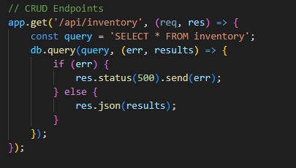
API IMPLEMENTATION
The following is an illustration of the endpoints that were created on the project:
READING: The following was the endpoint for fetching the inventory items

Slide 12
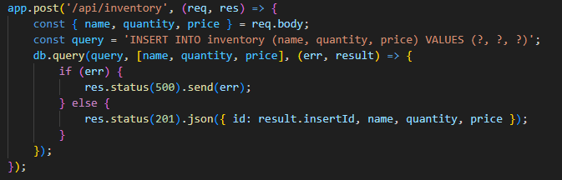
CREATING :Endpoint for saving an inventory item

Slide 13
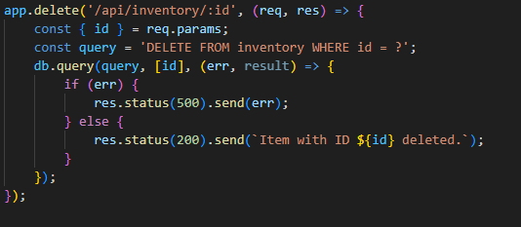
DELETING: The endpoint for deleting an inventory item

Slide 14
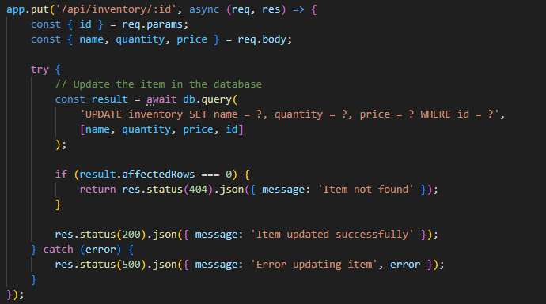
UPDATING: The endpoint for updating the inventory items

Slide 15
THE END

